Slide 1
Unit : 2 The Reference Model for Network Communication
Prepared By:
J B VALA
Computer Engineering Department, AVPTI, RAJKOT

Slide 2
Course Outcome
After completion of this unit, students will be able to…
Differentiate OSI and TCP/IP Models

Slide 3
Learning outcome
After completion of this session, students will be able to list all layers of OSI and TCP/IP model.

Slide 4
2.1 OSI Model
OSI is an Open System Interconnection model. The OSI model is developed by ISO.
An open system is a set of protocols that allows any two different systems to communicate regardless of their underlying architecture.
The purpose of the OSI model is to show how to facilitate communication between different systems without requiring changes to the logic of the underlying hardware and software.
The OSI model is NOT a protocol.
It is a model for understanding and designing a network architecture that is flexible, robust, and interoperable.
The OSI model has seven different separated layers each of which defines a part of the process of moving information across a network.
Notes:
OSI full model from Net, F, Technical, Atul etc.

Slide 5
Each layer uses the services provided by below layer and provide an interface to the upper layer.
Physical, Data link, Network, Transport, Session, Presentation and Application are the main seven layers of OSI model.

Slide 6
OSI Model Overview
Application
Application
(Upper)
Layers
Presentation
Session
Transport
Network
Data Flow
Layers
Data-Link
Physical
Notes:
Layer 2 of 2
Purpose: This figure orients the students to the next set of concepts.
Emphasize: The data link layer of the OSI reference model is implemented by switches and bridges. These devices encapsulate date in “frames.”
The network layer of the OSI reference model is implemented by routers. These devices encapsulate data in “packets.”
The transport layer of the OSI reference model is implemented by various protocols; one of which is TCP. TCP uses ports and encapsulates the data in “segments.”

Slide 7
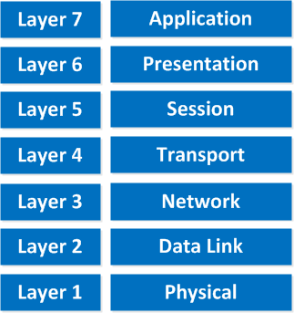
OSI reference model

Slide 8
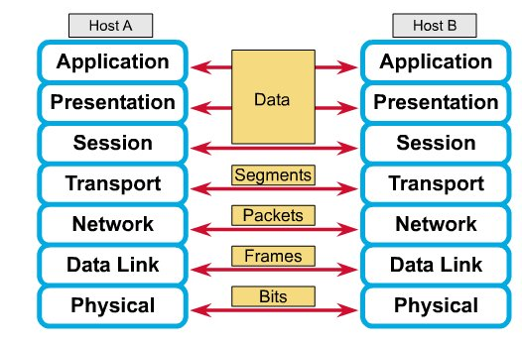
OSI reference model with host to host communication
Notes:
Frm Net

Slide 9
Role of Application Layers
Examples
User Interface.
(File,print,message,database,and application services)
Telnet, TFTP, FTP NFS, SMTP, LPD,
X WINDOW, SNMP, DNS, DHCP/BootP
Application
Notes:
Slide 1 of 4
Purpose: This figure orients the students to the application layer.
Emphasize: This layer discusses network applications rather than computer applications. Applications such as spreadsheets, word processors, or presentation graphics are not the applications being described here. Network applications may be applications that support electronic mail, file transfer, remote access, network management, and so on.
Transition: The following discusses the presentation layer.

Slide 10
Role of Application Layers
Examples
User Interface.
(File,print,message,database,and application services)
Telnet, TFTP, FTP NFS, SMTP, LPD,
X WINDOW, SNMP, DNS, DHCP/BootP
Application
How data is presented
such as data encryption, compression, translation services
PICT, TIFF, JPEG, MIDI, MPEG, QUICK TIME, RTF
Presentation
Notes:
Slide 2 of 4
Purpose: This figure orients the students to the presentation layer.
Emphasize: This layer discusses code formatting, data presentation standards, and conversion.
Transition: The following discusses the session layer.

Slide 11
Role of Application Layers
Examples
User Interface.
(File,print,message,database,and application services)
Telnet, TFTP, FTP NFS, SMTP, LPD,
X WINDOW, SNMP, DNS, DHCP/BootP
Application
How data is presented
(such as data encryption, compression, translation services)
PICT, TIFF, JPEG, MIDI, MPEG, QUICK TIME, RTF
Presentation
Keeping different applications’
data separate
NFS, SQL, RPC, X WINDOWS, ASP, DNA SCP
Session
Notes:
Slide 3 of 4
Purpose: This figure orients the students to the session layer.
Emphasize: This layer coordinates applications as they interact on different hosts. Examples of session-layer protocols include: NFS, SQL, RPC, and so on.
Transition: The following displays the lower layers.

Slide 12
Role of Application Layers
Examples
User Interface.
(File,print,message,database,and application services)
Telnet, TFTP, FTP NFS, SMTP, LPD,
X WINDOW, SNMP, DNS, DHCP/BootP
Application
How data is presented
such as data encryption, compression, translation services
PICT, TIFF, JPEG, MIDI, MPEG, QUICK TIME, RTF
Presentation
Session
Keeping different applications’ data separate
NFS, SQL, RPC, X WINDOWS, ASP, DNA SCP
Transport
Network
Data-Link
Physical
Notes:
Slide 4 of 4
Purpose: This figure orients the students to the entire OSI model stack.
Emphasize: The lower layers sit below the upper three layers. The remainder of this course focuses on the lower layers.
Transition: The following discusses the physical layer of the OSI reference model.

Slide 13
Role of Data Flow Layers
Examples
Move bits between devices
Specifies voltage, wire speed, and pin-out cables
Physical
EIA/TIA-232 V.35
Notes:
Slide 1 of 5
Purpose: This figure orients the students to the physical layer of the OSI model.
Emphasize: The physical layer specifies the electrical, mechanical, procedural, and functional requirements for activating, maintaining, and deactivating the physical link between systems.
Certain physical standards are associated with certain data-link standards. For example, 802.3 is used with data-link standard 802.2 for Ethernet. It is not used in WAN connections. This is covered more in-depth later in the course.
Transition: The following discusses Layer 2, the data link layer, of the OSI reference model.

Slide 14
Role of Data Flow Layers
Examples
Combines bits into bytes and bytes into frames
Access to media using MAC address
Error detection not correction
Data Link
802.3 / 802.2
HDLC
Move bits between devices
Specifies voltage, wire speed, and pin-out cables
Physical
EIA/TIA-232 V.35
Notes:
Slide 2 of 5
Purpose: This figure orients the students to the data link layer.
Emphasize: The data link layer provides data transport across a physical link. 802.3 is physical and data link Ethernet protocol. It is used with the 802.2 standard.
Transition: The following discusses Layer 3, the network layer of the OSI reference model.

Slide 15
Role of Data Flow Layers
Examples
Network
Provide logical addressing that routers use for path determination
IP
IPX
Combines bits into bytes and bytes into frames
Access to media using MAC address
Error detection not correction
Data Link
802.3 / 802.2
HDLC
Move bits between devices
Specifies voltage, wire speed, and pin-out cables
Physical
EIA/TIA-232 V.35
Notes:
Slide 3 of 5
Purpose: This figure orients the students to the network layer.
Emphasize: Network layer is where IP occurs.
Transition: The following discusses Layer 4, the transport layer of the OSI reference model.

Slide 16
Role of Data Flow Layers
Examples
Reliable or unreliable delivery
Error correction before retransmit
TCP
UDP
SPX
Transport
Network
Provide logical addressing that routers use for path determination
IP
IPX
Combines bits into bytes and bytes into frames
Access to media using MAC address
Error detection not correction
Data Link
802.3 / 802.2
HDLC
Move bits between devices
Specifies voltage, wire speed, and pin-out cables
Physical
EIA/TIA-232 V.35
Notes:
Slide 4 of 5
Purpose: This figure orients the students to the transport layer.
Emphasize: The transport layer of the OSI reference model is implemented by various protocols; one of which is TCP. TCP uses ports and encapsulates the data in “segments.” TCP is connection oriented so it offers reliable service. The other major transport layer protocol discussed in this course is UDP. It offers speed but no reliability because it is connectionless.
Transition: The following presents the entire OSI stack again.

Slide 17
Role of Data Flow Layers
Application
Presentation
Examples
Session
Reliable or unreliable delivery
Error correction before retransmit
TCP
UDP
SPX
Transport
Network
Provide logical addressing that routers use for path determination
IP
IPX
Combines bits into bytes and bytes into frames
Access to media using MAC address
Error detection, not correction
Data-Link
802.3/802.2
HDLC
Move bits between devices
Specifies voltage, wire speed, and pinout cables
Physical
EIA/TIA-232 V.35
Notes:
Slide 5 of 5
Purpose: This figure reviews the entire OSI model stack.
Emphasize: The upper layers sit above the lower layers.
Transition: The following discusses encapsulation and de-encapsulation.

Slide 18
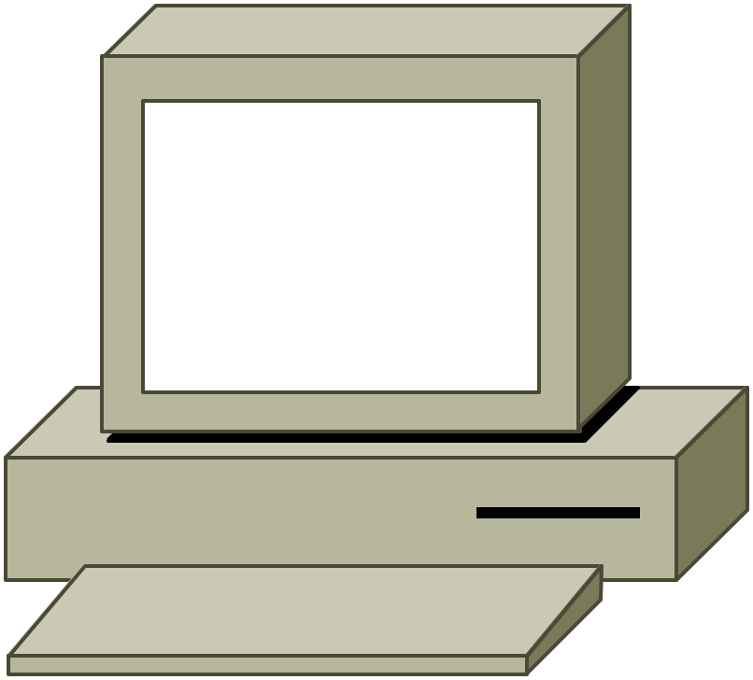
Encapsulating Data
Application
Presentation
PDU
Upper-Layer Data
Session
Transport
Segment
TCP Header
Upper-Layer Data
IP Header
Data
Network
Packet
LLC Header
Data
FCS
Data-Link
Frame
MAC Header
Data
FCS
Physical
Bits
0101110101001000010
Notes:
Purpose: This figure illustrates encapsulation.
Emphasize: The protocol data units (PDUs) is a term used in the industry and in this course to describe data at the different layers.
Encapsulation is a key concept that illustrates how data is formatted prior to being sent across a link. This example is an illustration of Ethernet (or Token Ring) at the data link and physical layer, and TCP/IP at the network and transport layers.
Transition: The following discusses de-encapsulation.

Slide 19
De-encapsulating Data
Application
Presentation
Session
Upper-Layer Data
Transport
Upper-Layer Data
Network
TCP Header
TCP+ Upper-Layer Data
IP Header
IP + TCP + Upper-Layer Data
Data-Link
LLC Header
LLC Hdr + IP + TCP + Upper-Layer Data
MAC Header
Physical
0101110101001000010
Notes:
Purpose: This figure illustrates de-encapsulation.
Emphasize: At the destination, the headers at each layer are stripped off as the data moves back up the stack.

Slide 20
Learning outcome
After completion of this session, students will be able to Describe functions of each layer of OSI reference model.

Slide 21
Following are the functions of each layer
Physical Layer
The layer is responsible for movement of individual bits from one hop (node) to next hop.
It is the lowest layer or first layer of the OSI model.
It is concerned with the transmission of raw bits over a communication channel.
At receiver side, It accept incoming stream of data and passes to the upper layer and also accept frames from upper layer (data link) and converts into bits.
Data unit at this layer is → ‘bit’.

Slide 22
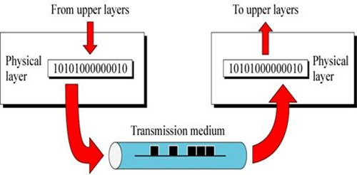
Physical Layer

Slide 23
Functions of Physical layer
It carries signals to higher layers
It defines the physical topology of a network.
It defines the direction of transmission between two devises: Simplex, Half duplex and Full duplex.
It encodes the bit streams into electric signals.
Hardware used at this layer are: hub, NIC, modem, Repeater .

Slide 24
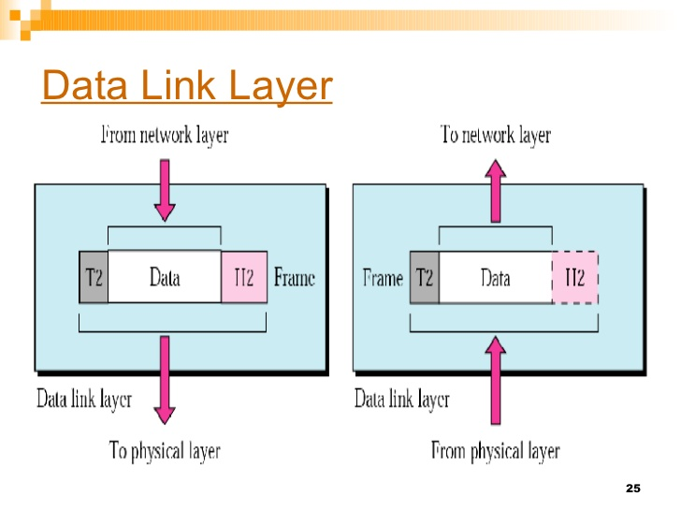
Data Link Layer
The layer is responsible for moving frames from one hop (node) to next hop.
It is the second layer of the OSI model in which raw bits are grouped into frames.
It makes the physical layer appear error free to upper layer (network).
It uses CRC (Cyclic Redundancy Check) to detect errors.
Data unit at this layer is → ‘frame’.

Slide 25
Functions of Data Link layer
Framing: converts packets received from network layers into frames and also converts bits from physical layer into frames.
Flow control: it provides data flow control when sender and receiver have different data rates.
Physical addressing: when frames are sent to different LANs, this layer adds sender and receiver address into header.
Error control: it provides facility of error control to retransmit the damaged and lost frames.
Data link layer has two sub layers
Logical Link Control (LLC) → it deals with protocols, flow control and error control.
Media Access Control (MAC) → it deals with the control of medium.

Slide 26
Hardware used at this layers are: switch, gateway, firewall, proxy servers etc.
Protocols and standards of this layer are:
PPP (Point to point protocol)
PPTP (Point to point tunneling protocol)
L2TP (Layer2 Tunneling Protocol)
SLIP (Serial Line Internet Protocol) etc.

Slide 27
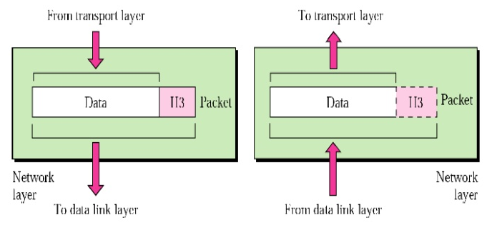
Network Layer
It is responsible for the delivery of packets from source host to destination host.
The network layer is responsible for the source-to-destination delivery of a packet across multiple networks (links).

Slide 28
Network Layer (cont.)
Network Layer End-Station Packet
IP
Header
Source Address
Destination Address
Data
Logical Address
172.15.1.1
Network
Node
Notes:
Slide 2 of 4
Emphasize: Route determination occurs at this layer, so a packet must include a source and destination address.
Network-layer addresses have two components: a network component for internetwork routing, and a node number for a device-specific address. The example in the figure is an example of an IP packet and address.

Slide 29
Functions of Network layer
Logical addressing: this layer adds a header into the packet includes logical address of sender and receiver.
Routing: this layer route the packets to its final destination in internetwork.
It provides quality of service management.
It provides security, load balancing and link management.
It provides connection oriented and connection less services to its upper layer (transport).
Hardware used at this layer are: router, layer3 switch, firewall, proxy server, gateway etc.
Protocols and standards of this layer are: ICMP, ARP, RARP, IPSec, IPv4/IPv6.

Slide 30
Transport Layer
The transport layer is responsible for the delivery of a message from one process to another.
It is responsible for source to destination delivery of a entire message, while network layer is responsible for source to destination delivery of individual packets.
Network layer doesn’t recognize any relationship between packets, while in case of transport layer, it ensures that whole message arrives in order and it also checks error control and flow control.
The data unit at this layer is → ‘segment’.

Slide 31
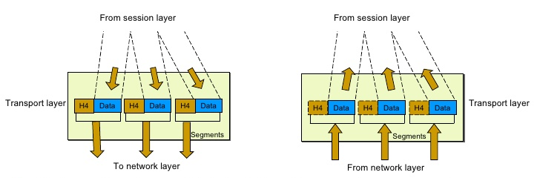
Transport Layer

Slide 32
The transport layer segments and reassembles data into a data stream.
Services located in the Transport layer both segment and reassemble data from upper-layer applications and unite it onto the same data stream.
They provides end-to-end data transport services and can established a logical connection between the sending host and destination host on an internetwork.
Transport layer user this two protocols :
TCP, UDP.
The Transport layer is responsible for providing mechanisms for multiplexing upper-layer applications, establishing sessions, and tearing down virtual circuits.
The transport layer can be connectionless, or connection-oriented.

Slide 33
Connection-Oriented Communication
In reliable transport operation, a device that wants to transmit set up a connection-oriented communication with a remote device by creating a session.
The transmitting device first establishes a connection-oriented session with its peer system, which is called a call setup, or a tree-way handshake.
Data is then transferred; when a call termination takes place to tear down the virtual circuit.

Slide 34
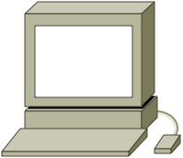

Reliable Transport Layer Functions
Sender
Receiver
Synchronize
Acknowledge, Synchronize
Acknowledge
Connection Established
Data Transfer
(Send Segments)
Notes:
Purpose: This figure illustrates a TCP connection being established.
Emphasize: The exchange is sometimes referred to as the “three-way handshake.” The initiating host requests a synchronization. The receiver acknowledges the synchronization and specifies synchronization parameters in the opposite direction. The receiver acknowledges the synchronization and a connection is established.

Slide 35
Functions of Transport layer
Segmentation and reassembly: a message divided into segments, each segment contains a sequence number which enables transport layer to reassemble at destination.
Synchronization of data: this layer ensures that data must be received in the sequence in which it was sent.
This layer provides error correction of data and ensures error free transmission.
Flow control: this layer performs end-to-end flow control while data link layer do it across the link.
Connection control: this layer performs connection less or connection oriented with the destination machine.
Hardware used at this layer are: gateway, proxy server, content filtering firewall, etc.
Protocols and standards of this layer are: TCP (Transmission Control Protocol) and UDP (User Datagram Protocol).

Slide 36
Summary of Layer Functions

Slide 37
Comparison Physical, Logical and Port Addresses
Features (Criteria) | Physical Address (MAC Address) | Logical IPv4 Address | Port Address
Layer in OSI Model | Data Link Layer (Layer 2) | Network Layer (Layer 3) | Transport Layer (Layer 4)
Scope | Local network segment | Across networks and internet | Within device and network
Format | Hexadecimal separated by colons or hyphens | Decimal separated by periods | 16-bit unsigned integer
Uniqueness | Globally unique | Unique within a network | Unique within a device and network
Assignment | Hardcoded into hardware | Dynamically assigned | Not hardcoded, assigned dynamically
Purpose | Identifies network interface | Identifies device on a network | Identifies service or application
Examples | 00:1A:2B:3C:4D:5E | 192.168.1.1 | 80 (HTTP), 443 (HTTPS), etc.

Slide 38
Learning outcome
After completion of this session, students will be able to Compare OSI and TCP/IP model

Slide 39
2.2 TCP/IP Model (Internet Model)
TCP/IP stands for Transmission Control Protocol / Internet Protocol.
TCP/IP model was developed before to the OSI model.
Therefore, the layers in the TCP/IP protocol suite do not exactly match those in the OSI model.
This model consist of set of protocols that allow communication across multiple different networks.
There are mainly four layers in this model → Host-to-network layer (Link layer), Internet layer , Transport layer and Application layer.
Notes:
TC-IP model frm Net, Technical, Atul, F etc

Slide 40
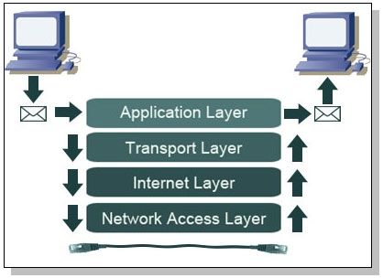
TCP / IP model
Notes:
Frm Net

Slide 41
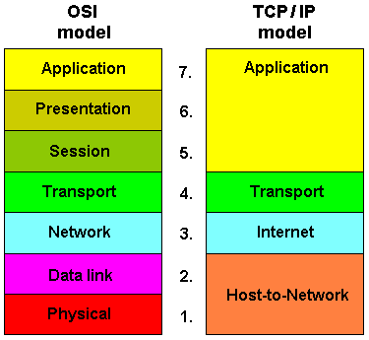
TCP / IP model (2)
Notes:
Frm Net

Slide 42
Following are the functions of each layer
Link layer (host-to-network) layer
It is also called ‘network interface layer’.
This layer provides mechanism of sending and receiving actual data.
This layer is independent of network architecture and hardware.
It controls hardware and media communication in the network.
Network layer (IP layer)
This layer defines the host addressing and routing.
It finds best path across networks.
IP (internet protocol) works on this layer. Including IP, this layer functioning with four supportive layers: ARP, RARP, ICMP and IGMP.
Packets in the IP layer called ‘datagram’.
The function of network layer is explained by following protocols

Slide 43
IP (Internetwork protocol)
It is connection less and unreliable protocol.
It doesn’t provide error checking and packet tracing.
ARP (Address Resolution Protocol)
ARP is used to find the physical address of the node when the logical address (IP address) is known.
RARP (Reverse Address Resolution Protocol)
It is used to find the logical address of the node when its physical address is known.
ICMP (Internet Control Message Protocol)
It is network diagnostic and error reporting protocol.
IGMP (Internet Group Message Protocol)
It is used provide facility for multicast transmission.

Slide 44
Transport layer
It supports communication of multiple devices across different networks.
It also defines how data should flow between different hosts.
This layer ensures data delivery between hosts is in order or not and also it is responsible for end-to-end delivery.
Major protocols of this layer are: TCP and UDP. Both these protocols are used for port-to-port communication.
TCP (Transmission Control Protocol)
It provides full transport layer services to application.
It is connection oriented and reliable protocol. Means a connection must be established between both ends before transmission.
The packet produced by TCP is called ‘segment’.

Slide 45
UDP (User Datagram Protocol)
It is simple, connection less and unreliable protocol.
The packet produced by UDP is called ‘datagram’.
Application Layer
It is the final and highest layer in TCP/IP model which is equal to the combined session, presentation and application layer of OSI model.
The functions of this model are explained by the following protocols.
SMTP (Simple Mail Transfer Protocol)
It is used to transfer electronic mail (E-mail) from one user to another.
HTTP (Hyper Text Transfer Protocol)
Is provides a standard for web users and servers to communicate.

Slide 46
FTP (File Transfer Protocol)
FTP is the most widely used protocol for file transfer over the network.
It is reliable and simple.
It uses TCP/IP for communication and it works on TCP port 21.
HTTP (Hyper Text Transfer Protocol)
Is provides a standard for web users and servers to communicate.
SNMP (Simple Network Management Protocol)
It provides a set of operations for monitoring and maintaining devices in the internet.
TELNET (Terminal Network)
It is a general purpose protocol used for remote login.
DNS (Domain Name Server)
It resolves an IP address into textual address for hosts connected over a network.

Slide 47
Learning outcome
After completion of this session, students will be able to differentiate between connection oriented and connectionless services/approach.

Slide 48
2.3 Connection oriented v/s Connection less services
Connection oriented services | Connection less services
- In connection oriented service we have to establish a connection before starting the communication. | - No need to establish a connection in prior.
- it is more reliable | - It is less reliable
- Authentication is needed in it. | - Authentication is not needed.
- After sending, this service checks the message is received or not. | - there is no guarantee of a delivery of message.
- It is slower. | - It is faster.
- It is implemented using circuit switching. | - It is implemented using packet switching.
- Error correction and flow control provided in it. | - Error correction and flow control not provided.
- Example is telephone system. | - Example is postal system.
- Protocol: TCP (transmission control protocol) | - Protocol: Example: UDP (User Datagram Protocol)
Notes:
From Net

Slide 49
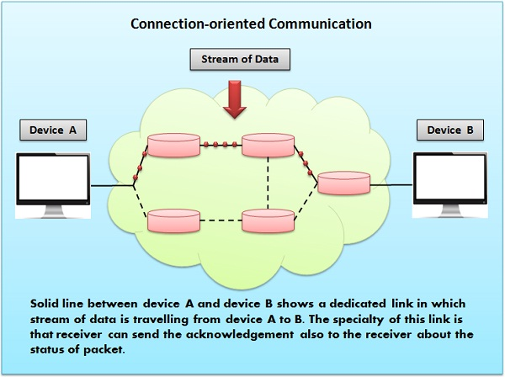
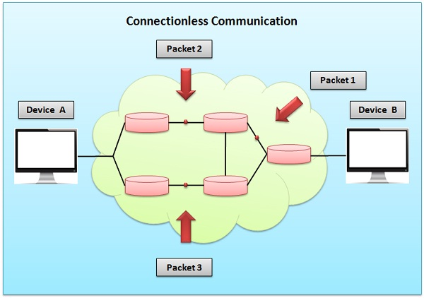

Slide 50
Learning outcome
After completion of this session, students will be able to compare OSI and TCP/IP model.

Slide 51
2.4 Comparison of OSI and TCP/IP models
OSI | TCP/IP
- Full form: Open System Interconnection. | - Full form: Transmission Control Protocol / Internet Protocol.
- It has seven layers. | - It has four/five layers.
- OSI model developed after TCP/IP model. | - It is developed before OSI model.
- In this model, transport layer guarantees the delivery of packets. | - In this model, transport layer does not guarantees delivery of packets.
- It follows vertical approach. | - It follows horizontal approach.
- OSI model has separate presentation layer and session layer. | - TCP/IP model does not have separate presentation and session layer.
- Network layer in this model provides both connection less and connection oriented service. | - Network layer in this model provides only connection less service.
- In it, services, interface and protocols are clearly separated. | - In it, services, interface and protocols are not clearly separated.
- It is just a reference model. | - It is the implementation of OSI model.
Notes:
Frm net

Slide 52
Thank You…

